Slide 1


270
255
75

Slide 2
Catching N point (½, ½,0)
Ei=401
Ei=787
dE=200+20
dE=200+20
Ei=787
dE=220+20
dE=220+20
dE=220+20
dE=240+20
dE=240+20
dE=240+20
Π-no
- spur
dE=260+20
dE=260+20
G
dE=260+20
D?
dE=280+20
dE=280+20
dE=360+20
Ei=787
dE=300+20
dE=320+20
dE=340+20
Removed background

Slide 3
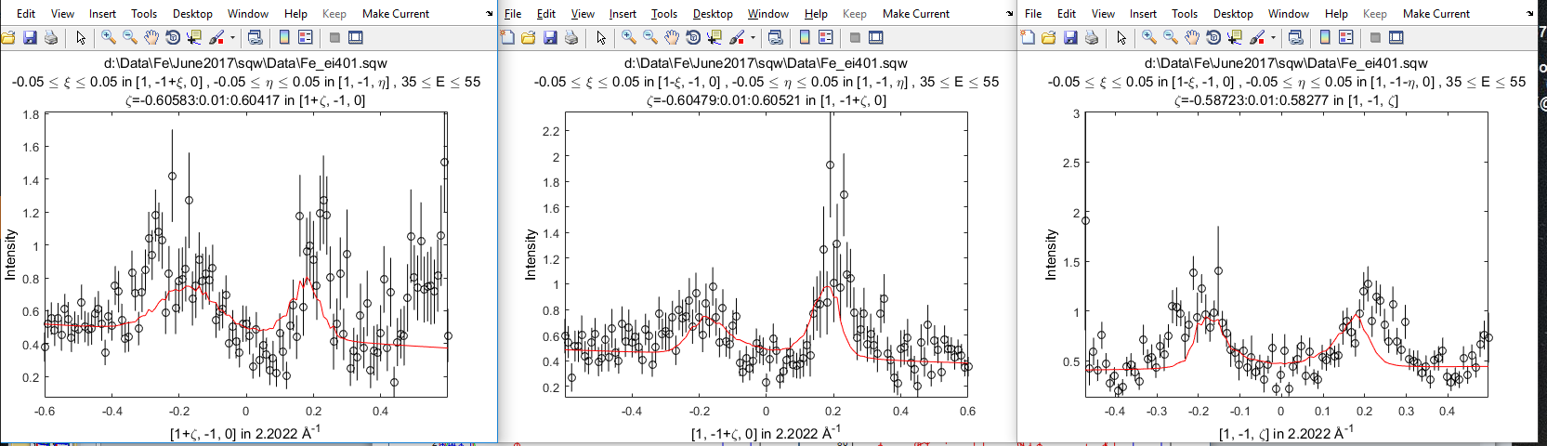
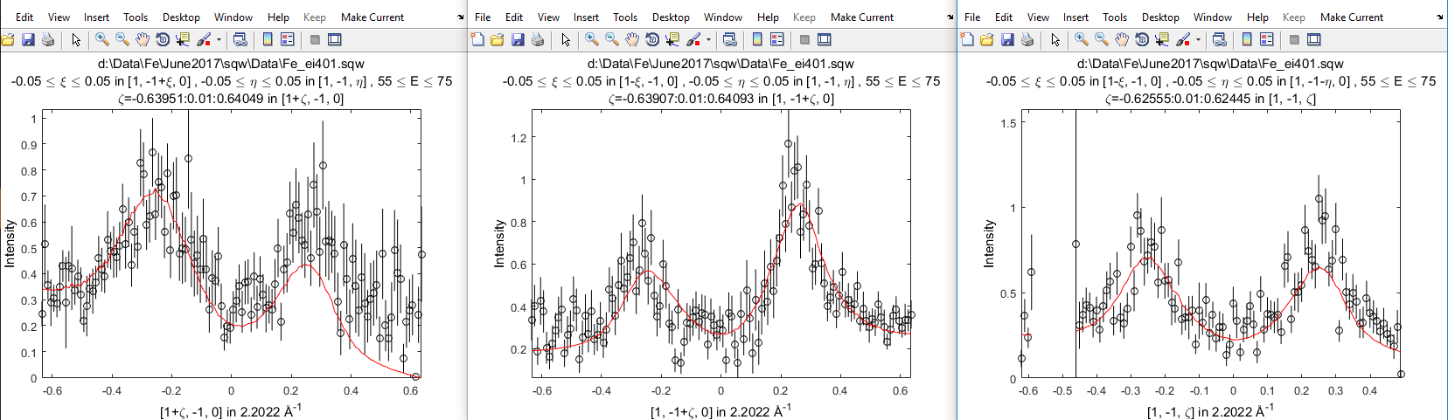
[1,-1,0] fitting with J0
Ei45
Ei65

Slide 4
[1-1 0]
Ei200 fit with J from Ei400 fit

Slide 5
[1 1 0]
J0-2

Slide 6
Realigned Fe401:
Old:
New:

Slide 7
Realigned Fe200:
Old:
New:

